Slide 1

ML CLASSIFICATION ALGORITHM
Vinit Jha (34)
Aditya Joshi(35)
Jay Natholia (44)

Slide 2

Problem Statement
In this we will be working with a fake advertising data set, indicating whether or not a particular internet user clicked on an Advertisement on a company website.

Slide 3
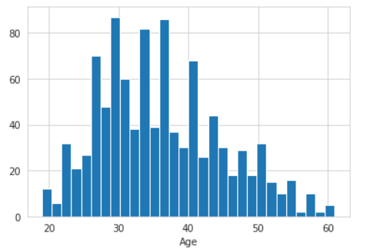
Data Analysis and Test Splitting
1. For this project we will make use of libraries like:
scikit-Learn
Seaborn
Matplotlib
Numpy
Pandas
2. Through the use of data visualization tools like Seaborn and Matplotlib, we can create graphs to represent data which can help us find patterns and determine which machine learning algorithm to use.
3. After the above mentioned steps, we split the data into 2. One part will go for training the data and the other will go for testing the model after its training phase.

Slide 4
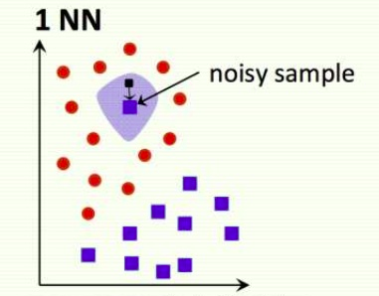
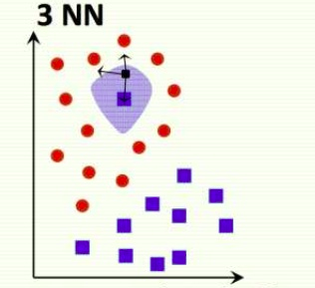
KNN Classification
It is a powerful algorithm used for classification problems
K nearest neighbours stores all available cases
and classifies new cases based on a similarity measure
PROS:
Very Simple
Training is trivial
Easy to add more data
CONS:
Not good for large datasets
Categorical features don’t work well

Slide 5
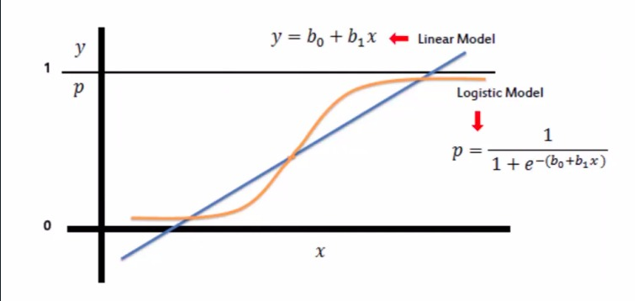
Logistic Regression
In this particular problem, we have to determine whether an individual will click on an ad or not.
This is an example of classification problem
The method of Logistic Regression is used in order to solve this problem.
In some scenarios the linear regression can yield the probability values out of standard range as we can see in the given graph.
Logistic Regression rectifies this problem and provides the required values in range from 0 to 1
As we can see in the graph, the linear model is a straight line
whereas the logistic model is a curve between 0 and 1.
The curve is a graph of a sigmoid function.

Slide 6
Conclusion
The users that are predicted to click on commercials and the actually clicked users were 116, the people who were predicted not to click on the commercials and actually did not click on them were 132.
The people who were predicted to click on commercial and actually did not click on them are 7, and the users who were not predicted to click on the commercials and actually clicked on them are 15.
Classification Report: The precision & recall of the KNN model is 0.8 which depicts the predicted values are 80% accurate while the precision and recall of the logistic regression model is 0.92 which depicts the predicted values are 92% accurate . Thus we will be accepting the Logistic Regression model as it has higher accuracy. Hence the probability that the user can click on the commercial is 0.92 which is a great precision value to get a good model.
132 | 7
15 | 116

